Slide 1


HADOOP
ECO SYSTEM
PRESENTED TO:
Dr. Syed Abbas

Slide 2
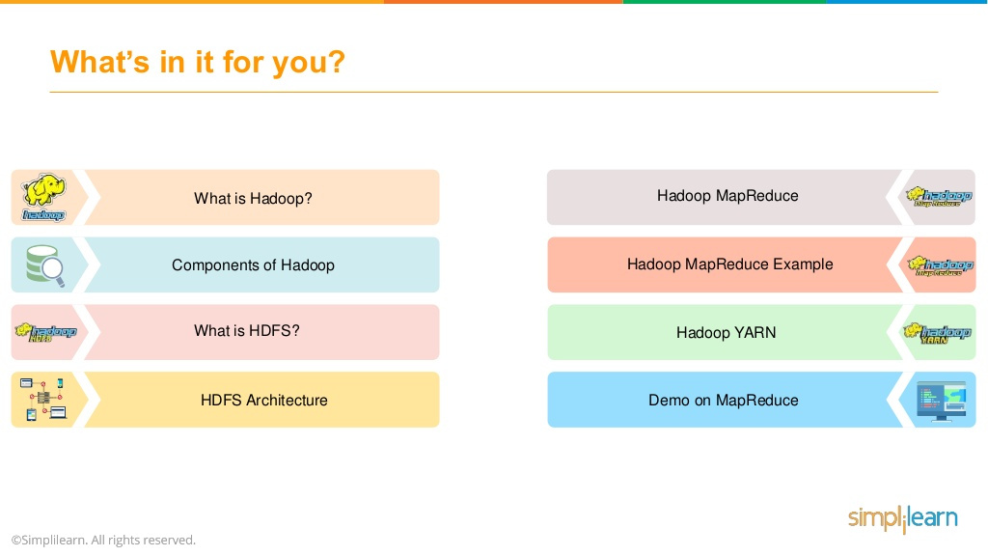
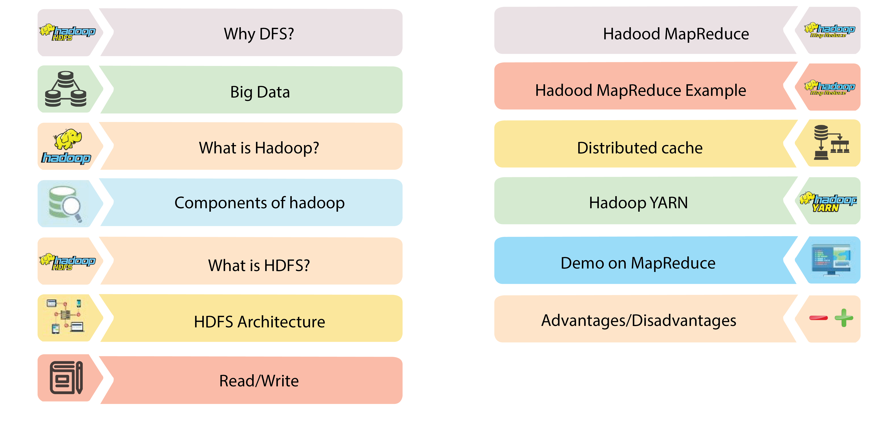



Slide 3

Big Data

Slide 4
Big Data
Data evolved in last 5 to 10 years was never before!!!
4.4 billion internet users and they are generating massive amount data
All this data collectively term as BIG data
?
How this managed and processed
Why there is rushed to big data ,
what is happening and why are their organizing ?

Slide 5
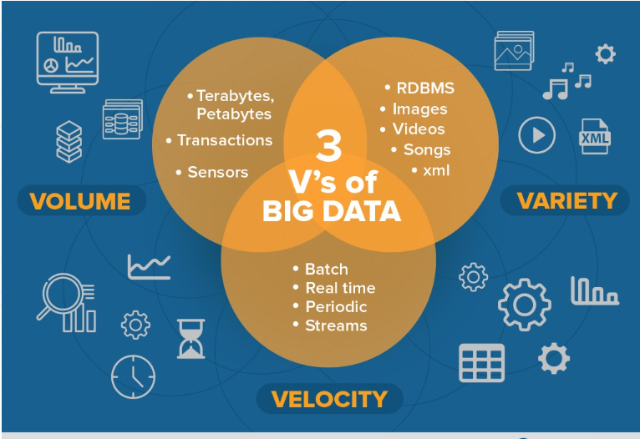

Slide 6
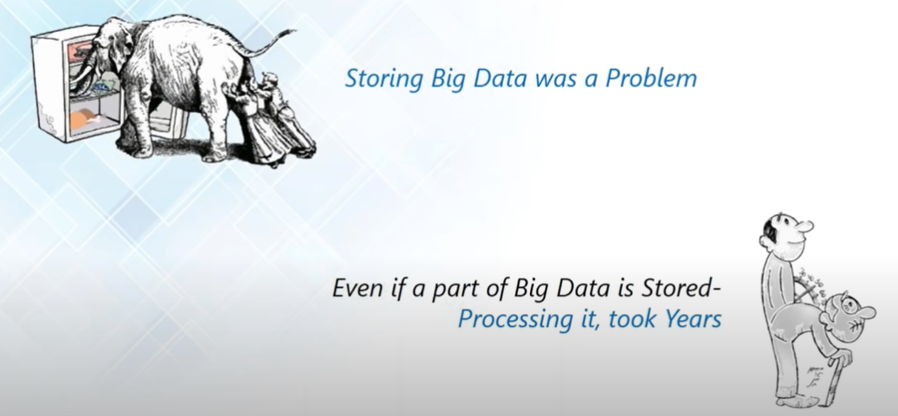

Slide 7
What is DFS

Slide 8
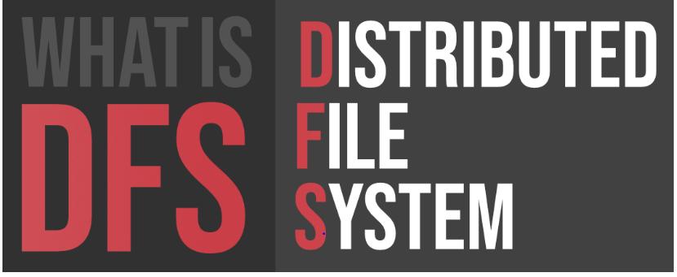
A file system that is distributed on multiple file servers and/or multiple locations.
Main purpose of the Distributed File System (DFS) is to allows users of physically distributed systems to share their data and resources by using a Common File System

Slide 9
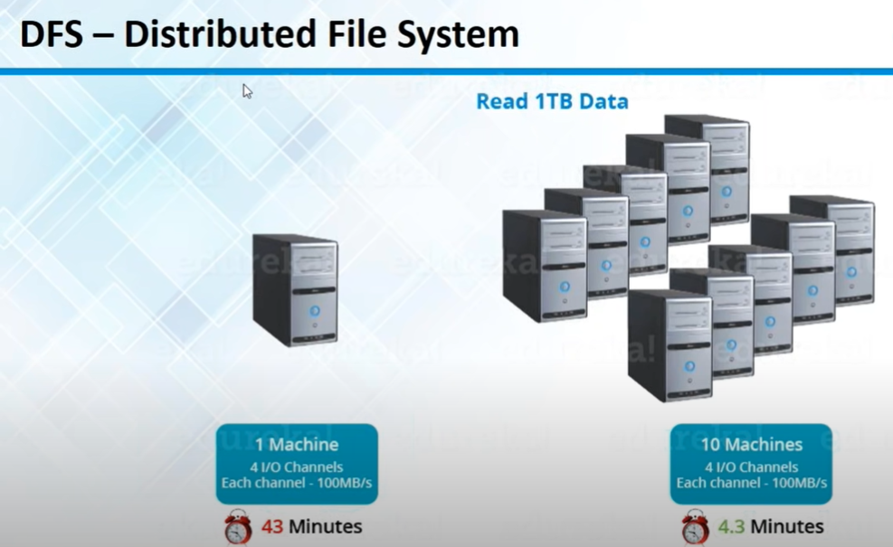

Slide 10
Why DFS

Slide 11
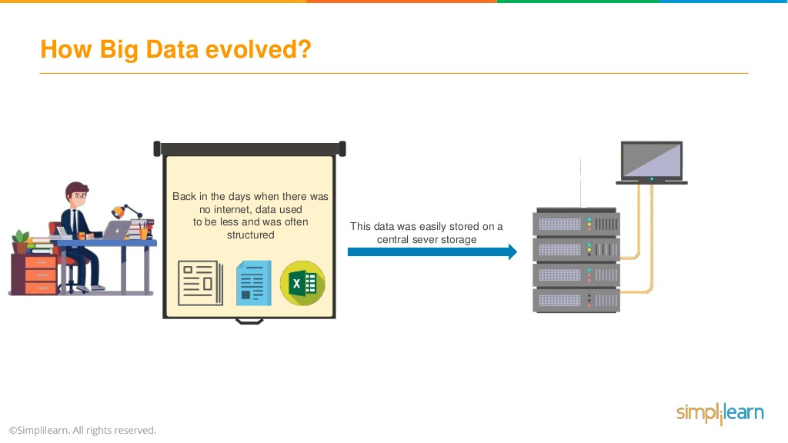

Slide 12
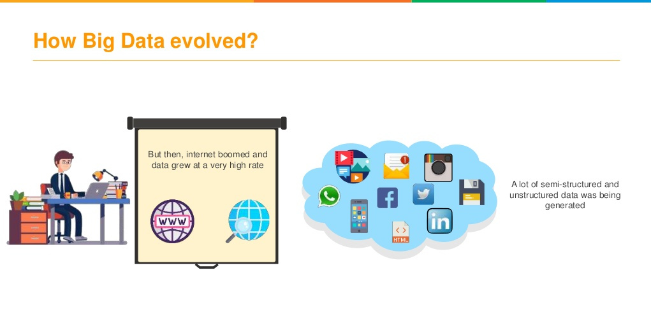

Slide 13
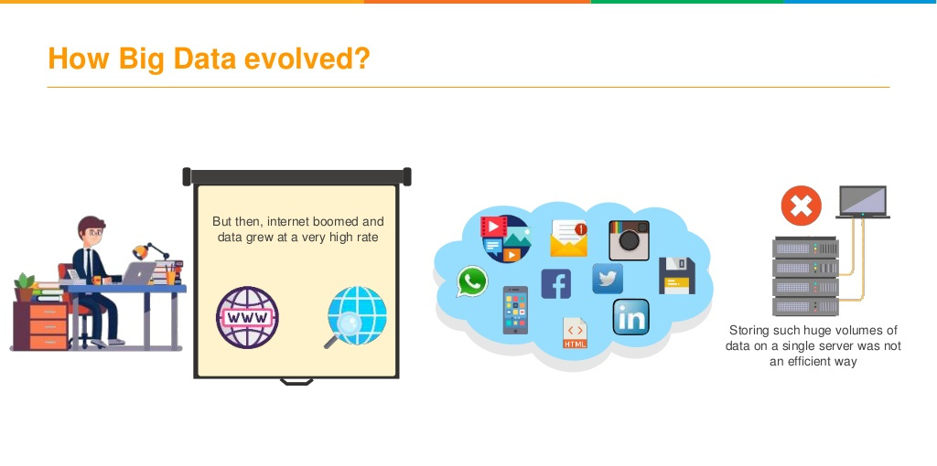

Slide 14
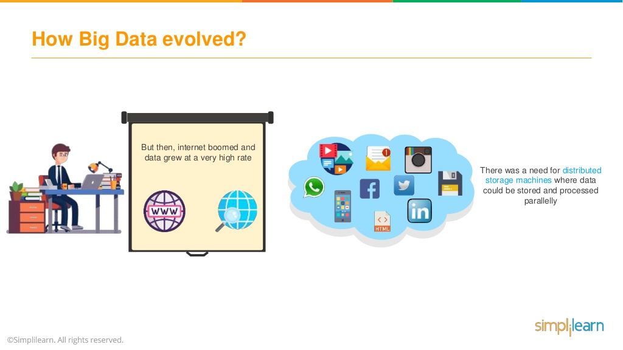

Slide 15
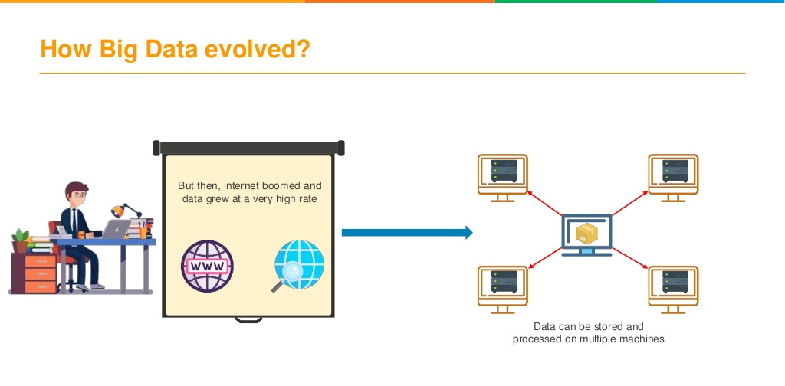

Slide 16
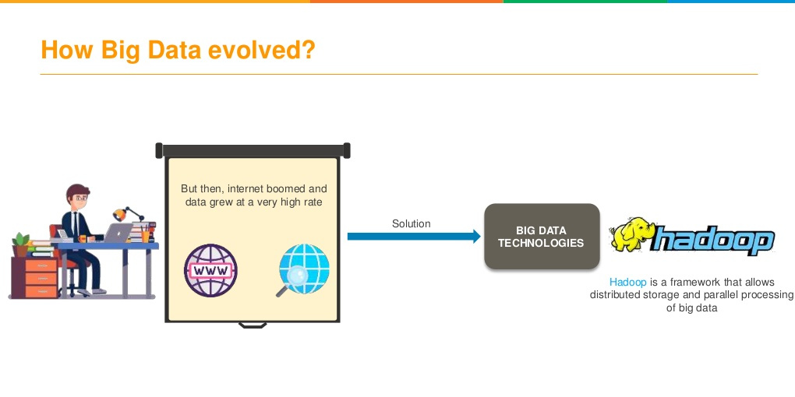

Slide 17
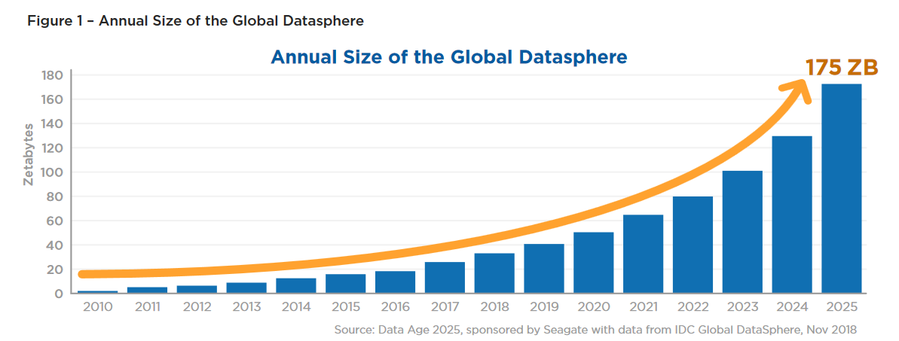
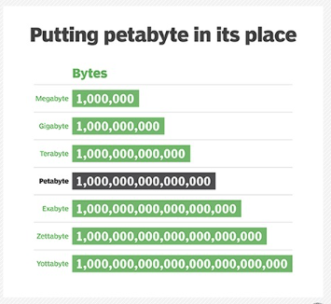

Slide 18
Big Data Challenges
Data to be explored and exploited by computing systems increases at an
exponential rate.
Massive amount of data or so-called “Big Data” put pressure on existing technologies for providing scalable, fast and efficient support.
“Big data” encompass a wide range of the tremendous data generation from various sources such as mobile devices, social media applications ,IOT devices, digital repositories, and enterprise applications.
Traditional Systems & Data storage devices can’t handle & process huge volume of data

Slide 19


Slide 20
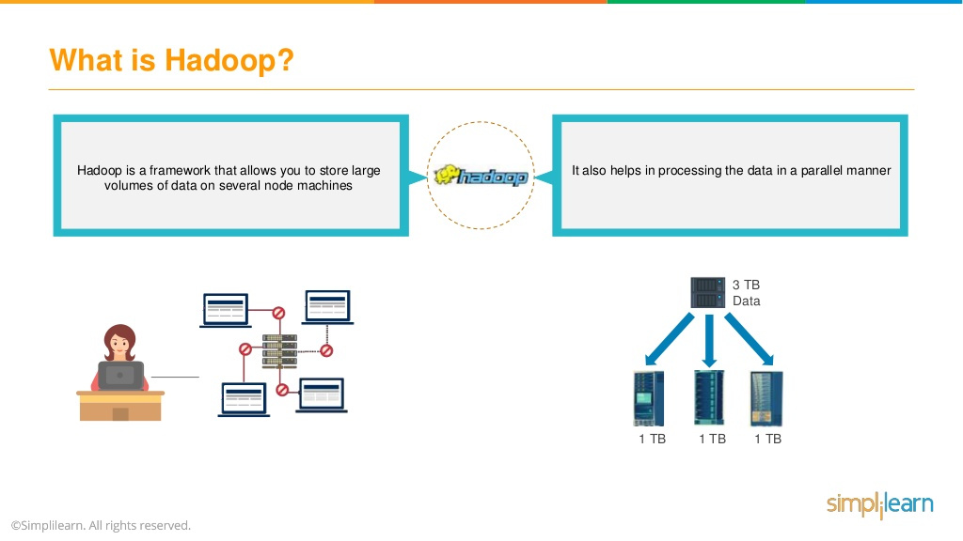

Slide 21


Slide 22
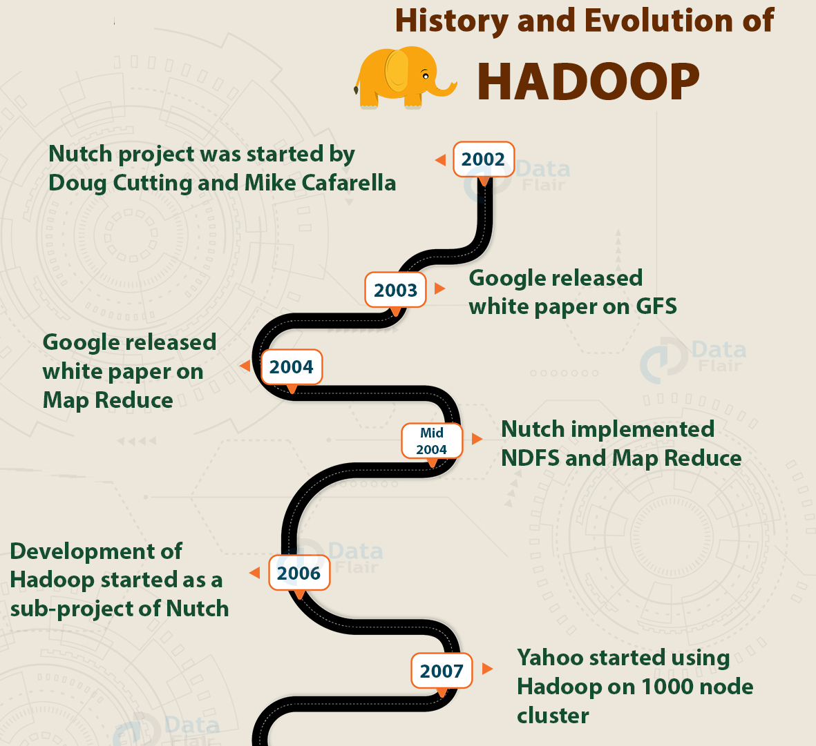

Slide 23
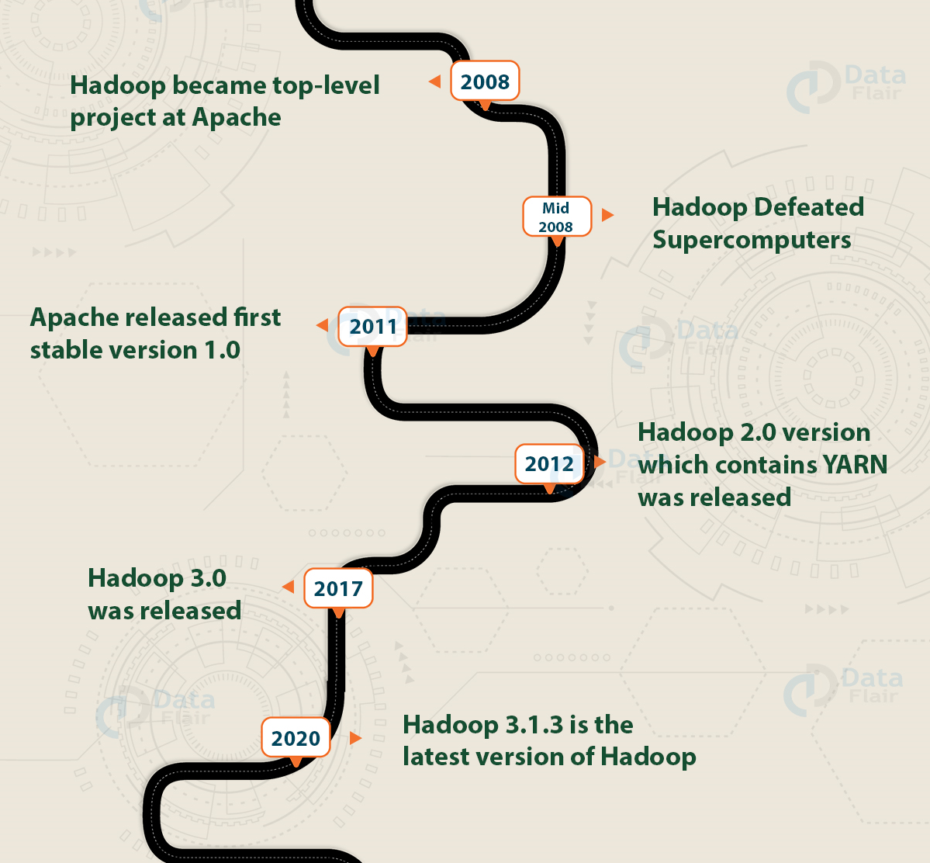

Slide 24


Slide 25
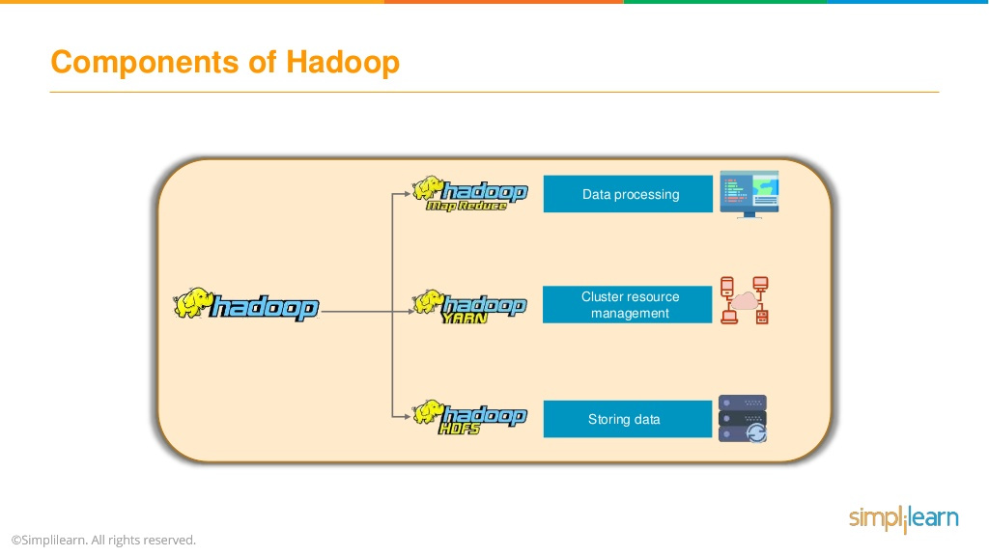
Programming model
Structure data -> Hive
Streaming -> Sparc , Cafca
Batch base data /Processing
Map Reduce
Processing Layer
Mechanism to process data parallely across the nodes
Resource Management
Storage Layer
Store data on multiple data server or slave node

Slide 26
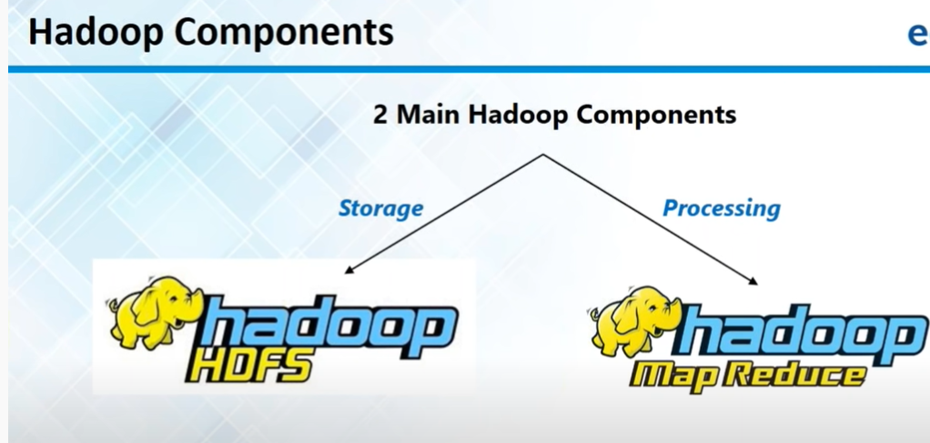

Slide 27


Slide 28
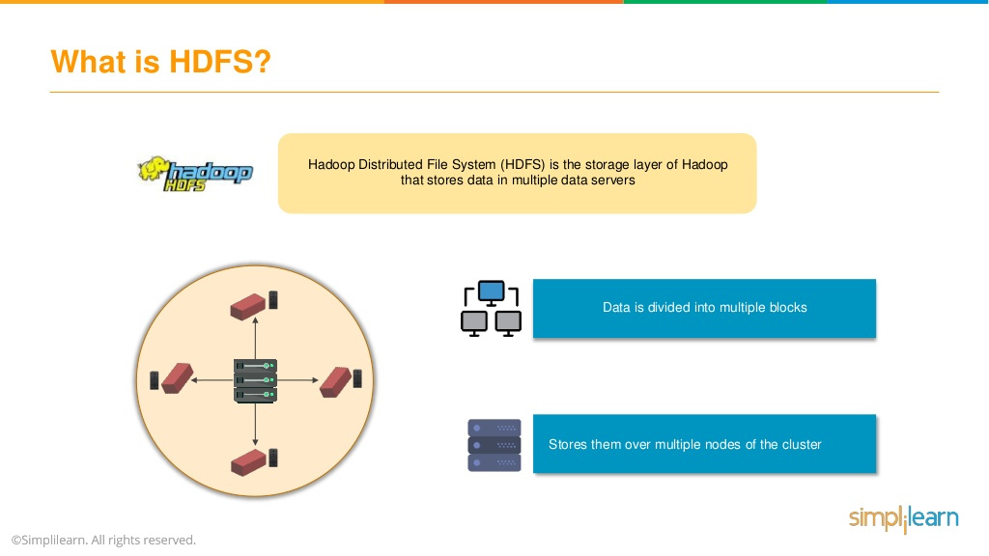

Slide 29
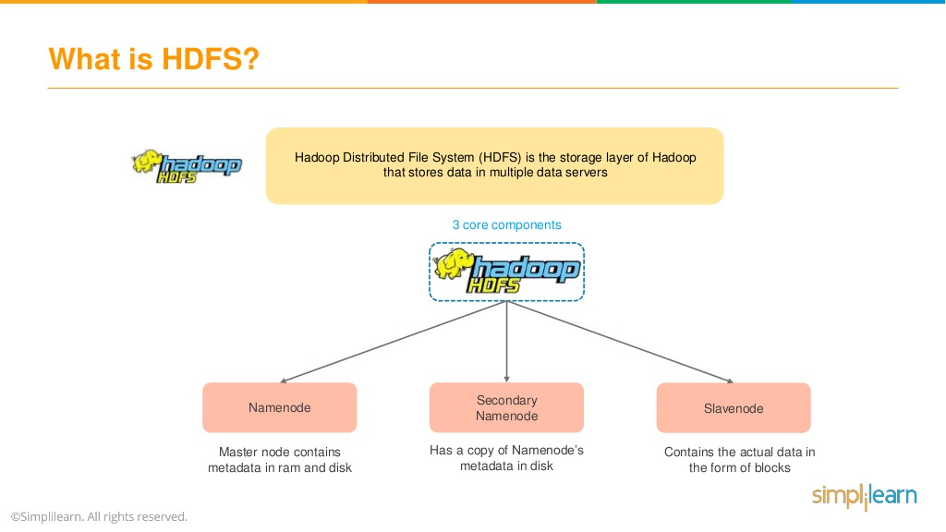

Slide 30


Slide 31
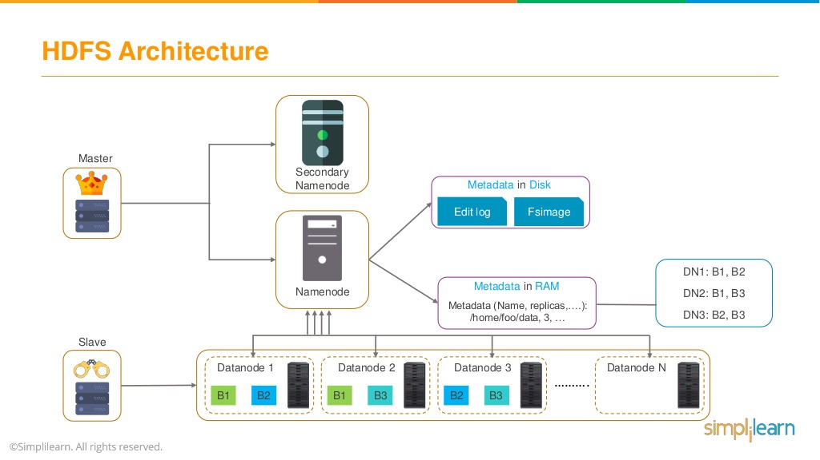

Slide 32
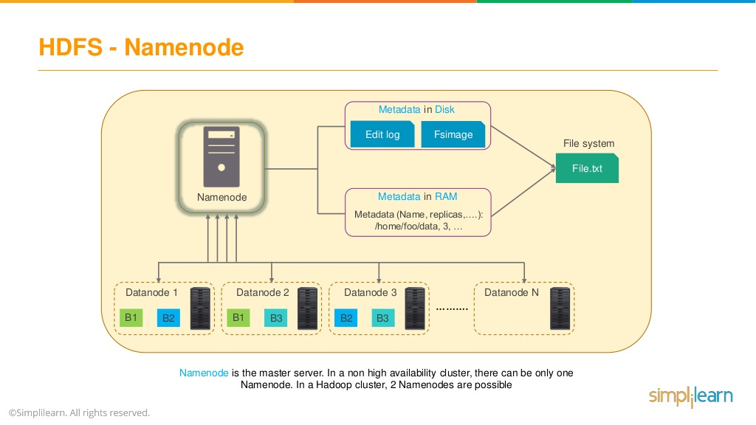

Slide 33
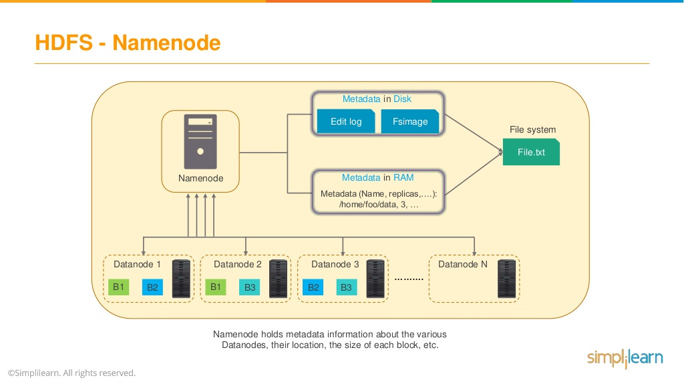

Slide 34
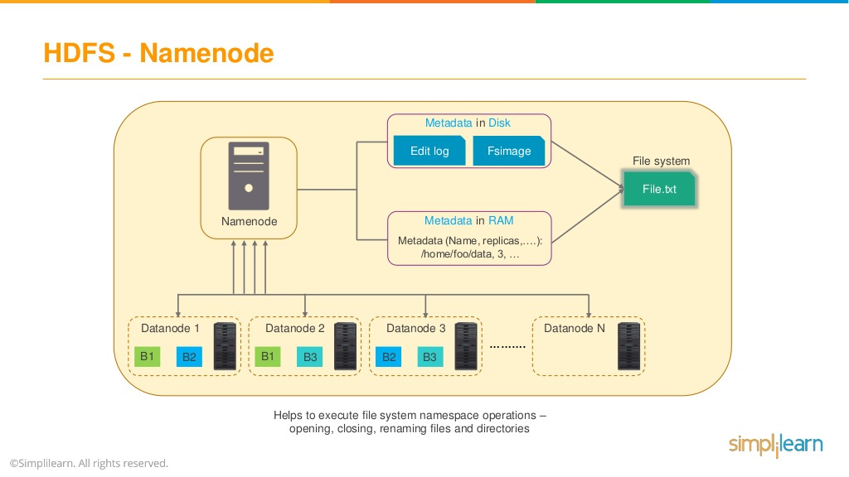

Slide 35
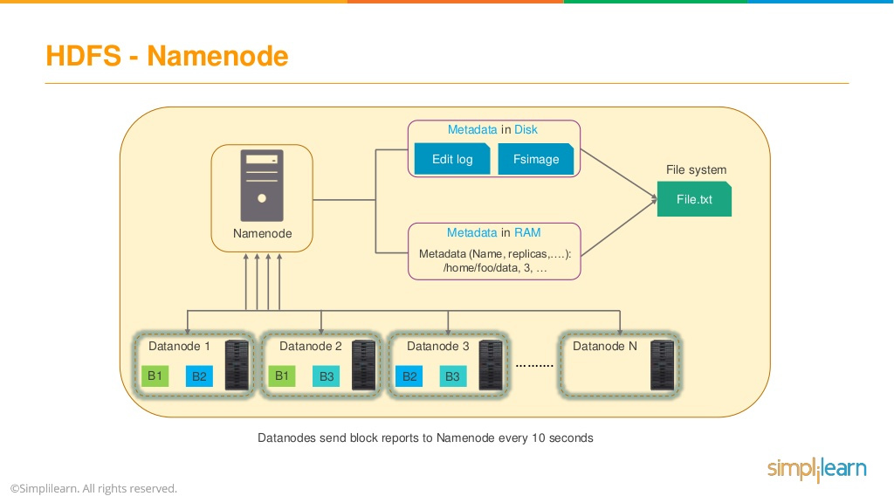

Slide 36
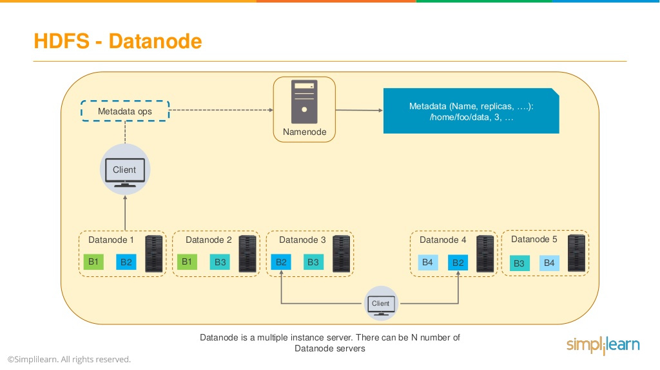

Slide 37


Slide 38


Slide 39
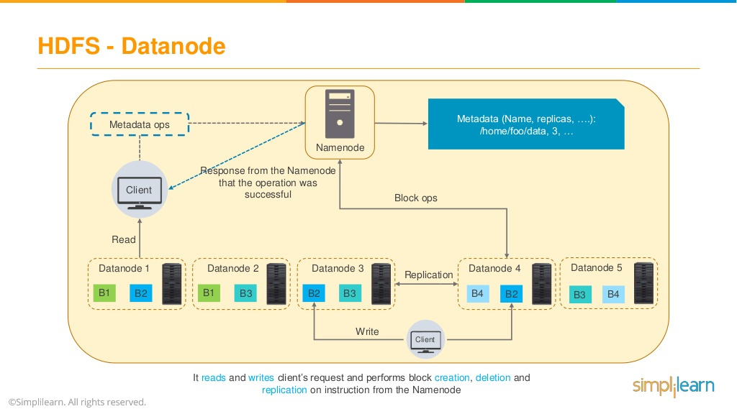

Slide 40
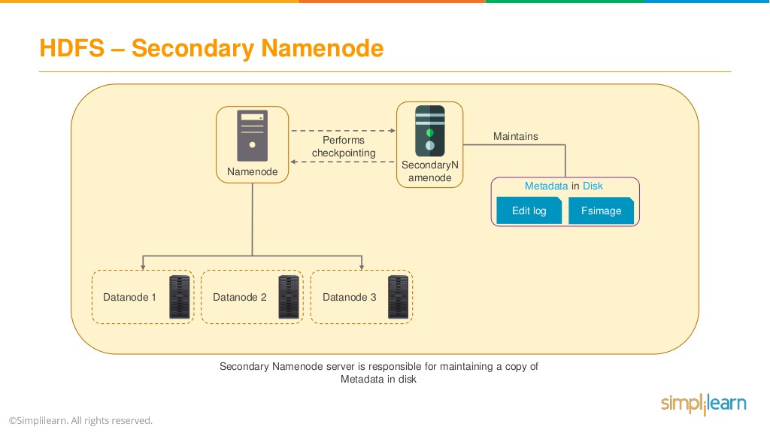

Slide 41
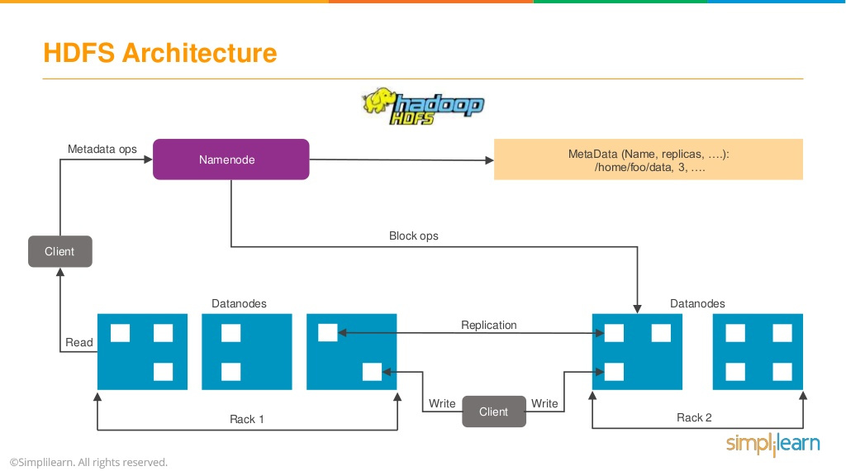

Slide 42
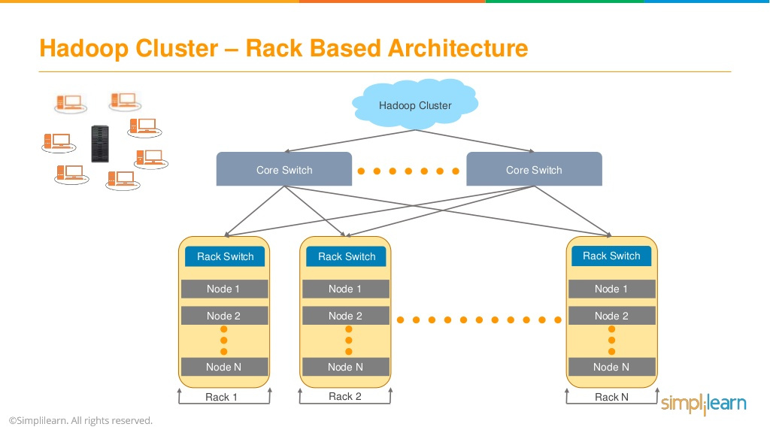

Slide 43


Slide 44
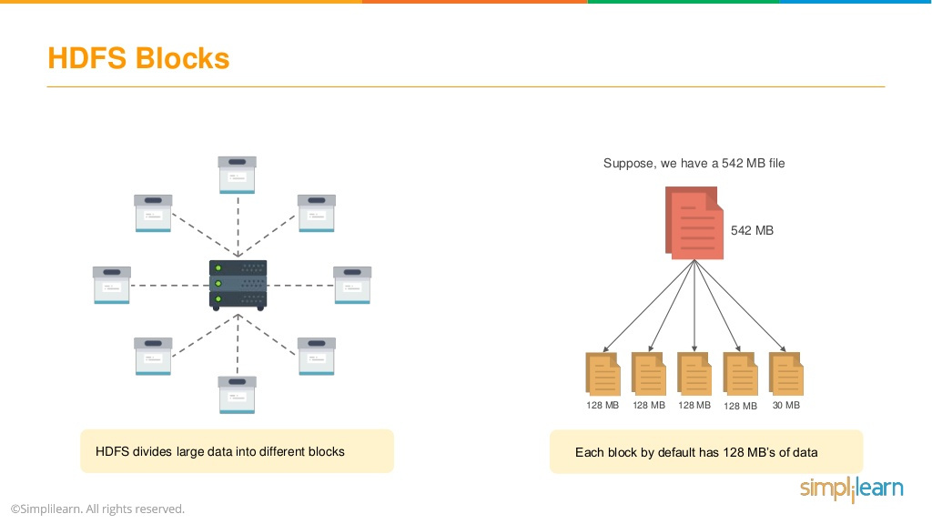

Slide 45


Slide 46
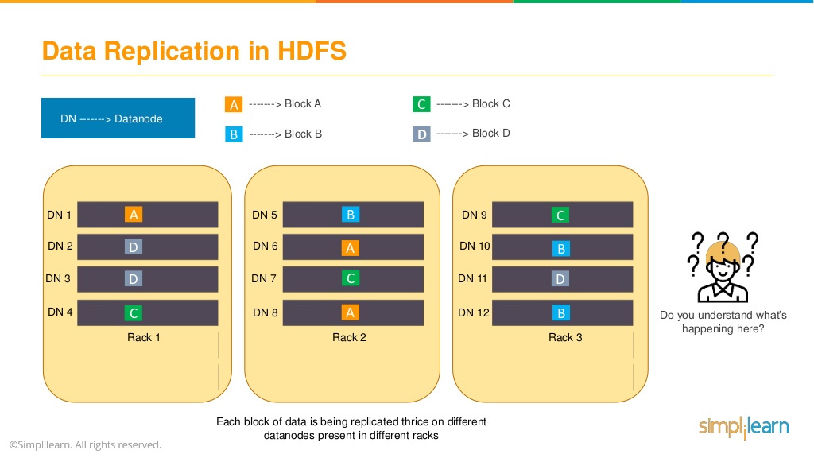

Slide 47
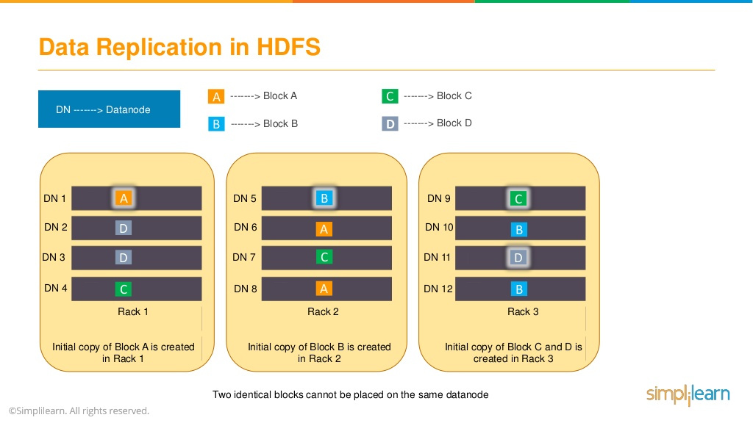

Slide 48


Slide 49
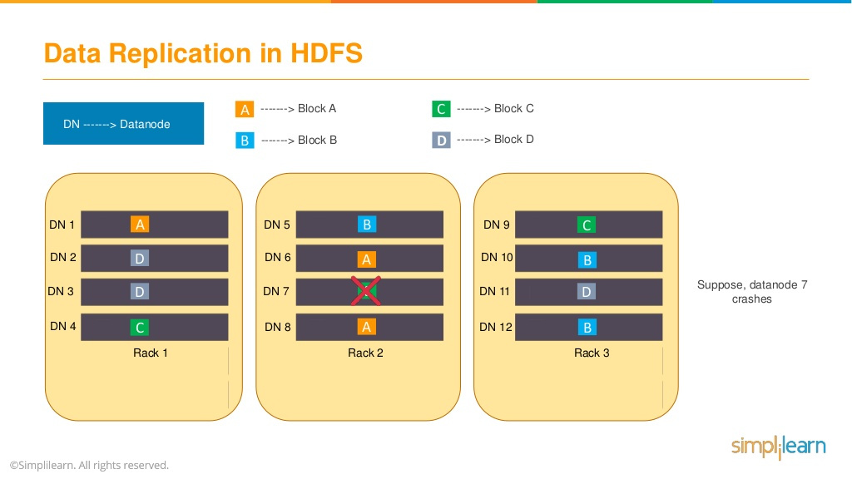

Slide 50
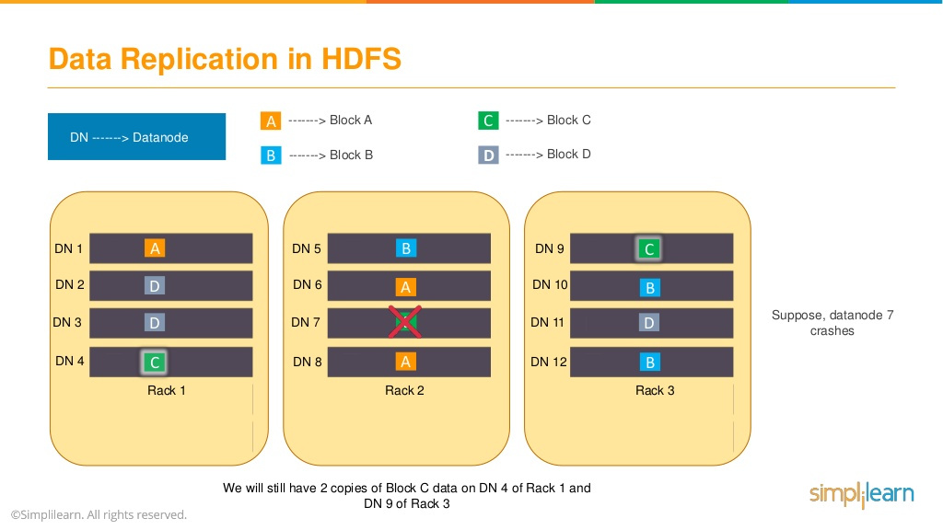

Slide 51


Slide 52
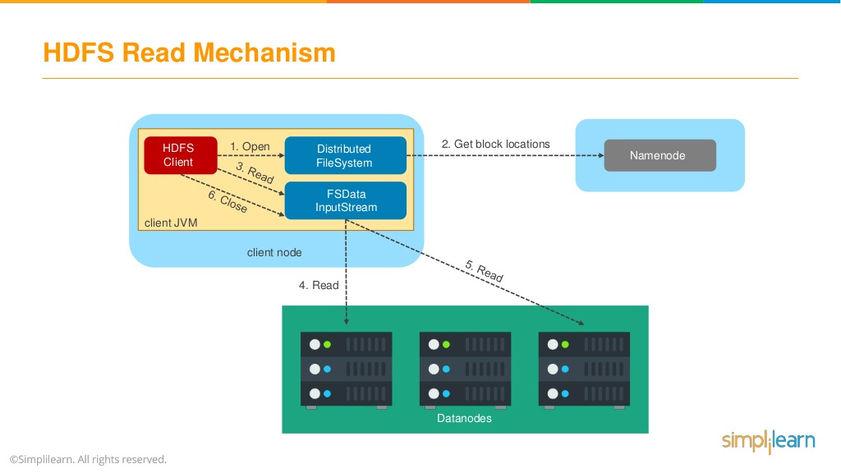

Slide 53
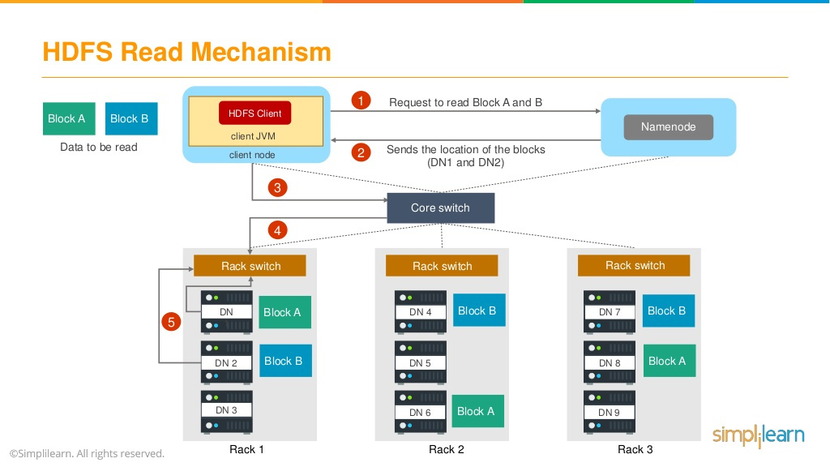

Slide 54
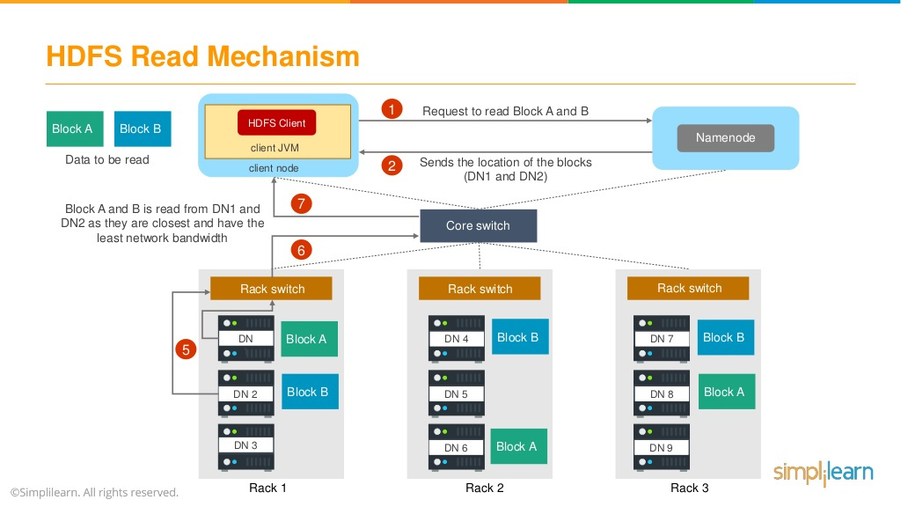

Slide 55


Slide 56
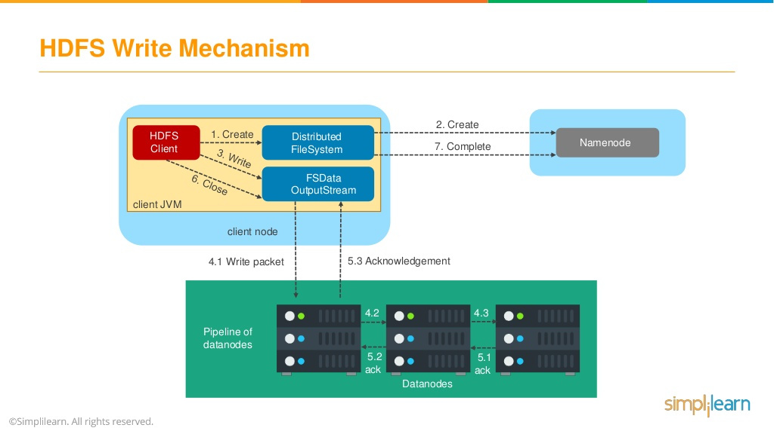

Slide 57
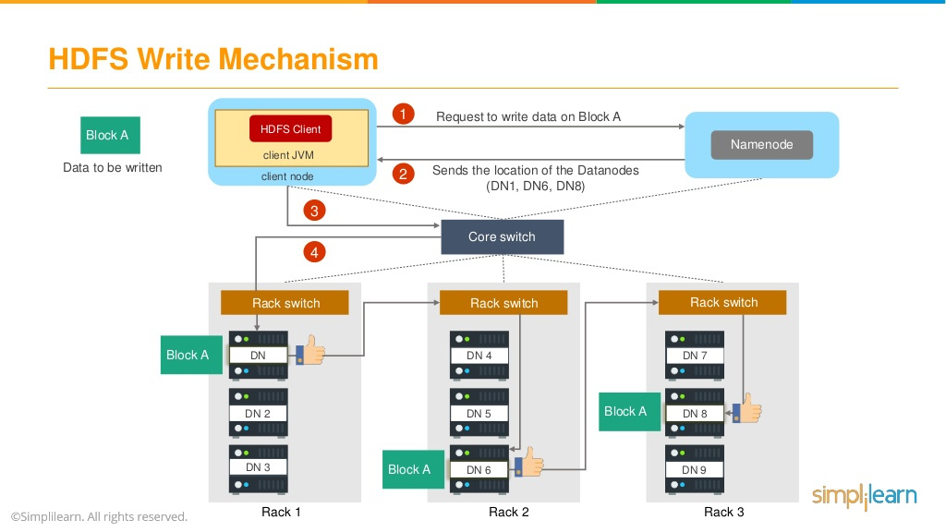

Slide 58
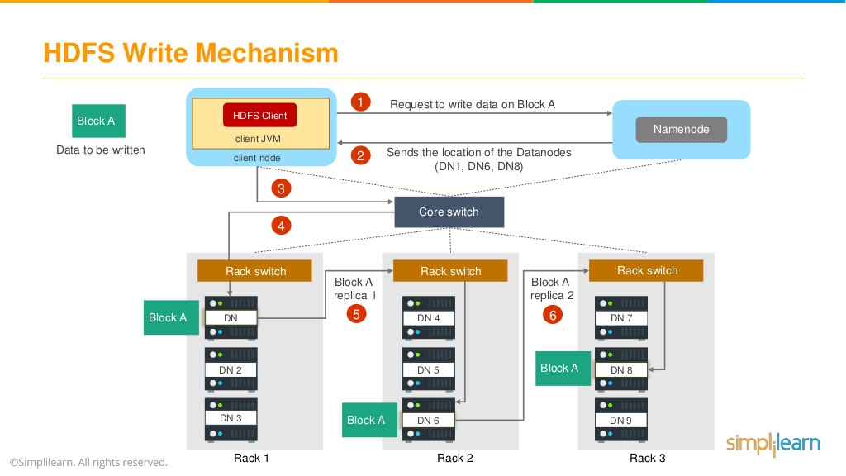

Slide 59
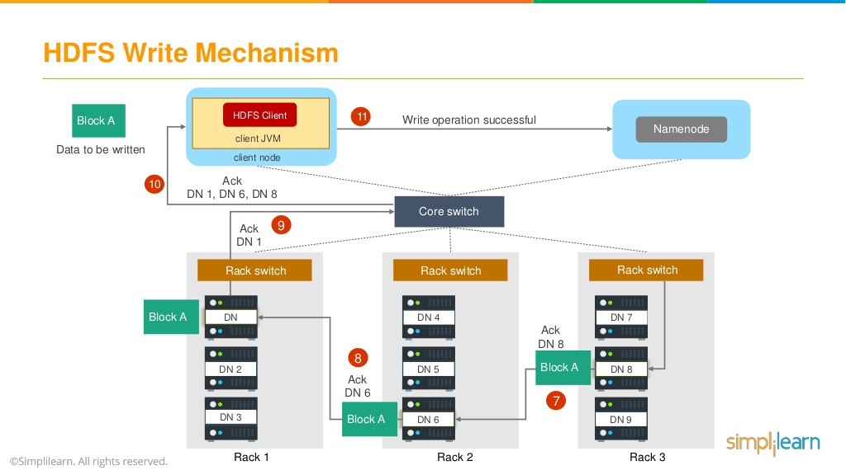

Slide 60


Slide 61
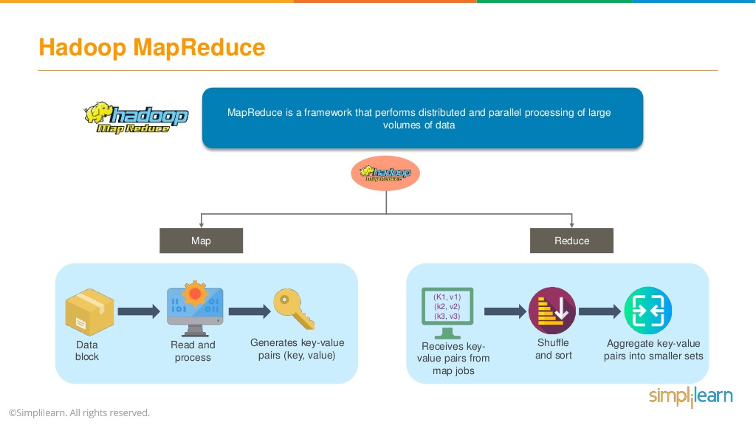

Slide 62
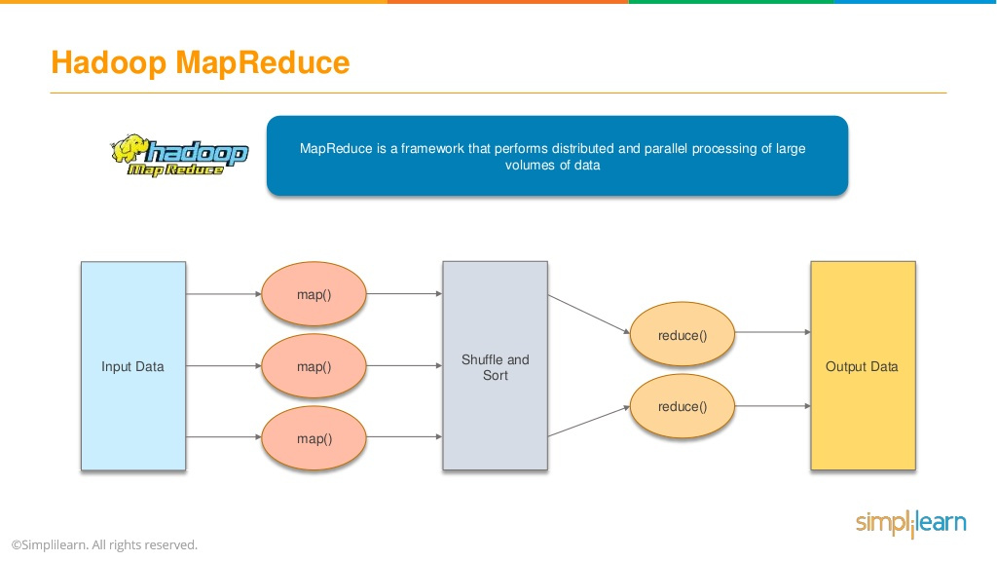

Slide 63
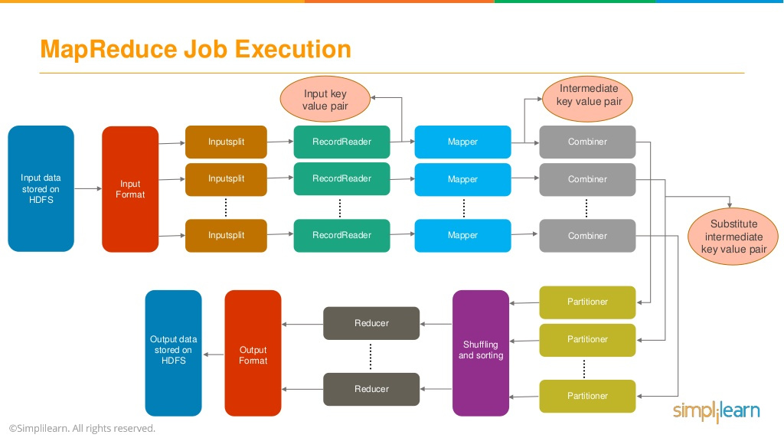

Slide 64
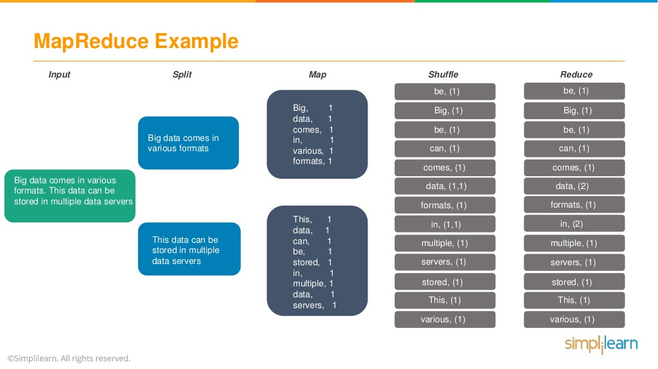

Slide 65


Slide 66
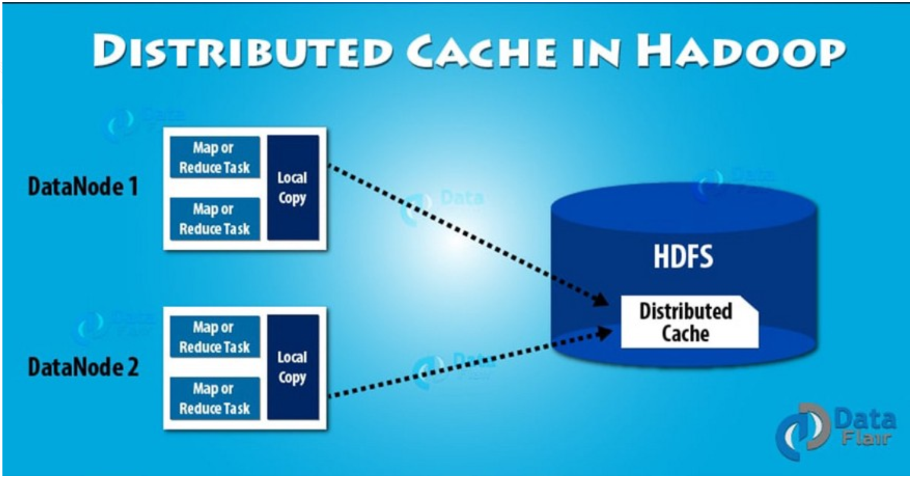

Slide 67
Distributed Cache in Hadoop
Distributed cache in Hadoop is a way to copy small files or archives to worker nodes in time.
Hadoop does this so that these worker nodes can use them when executing a task.
It saves the network bandwidth by coping the files once per job.

Slide 68
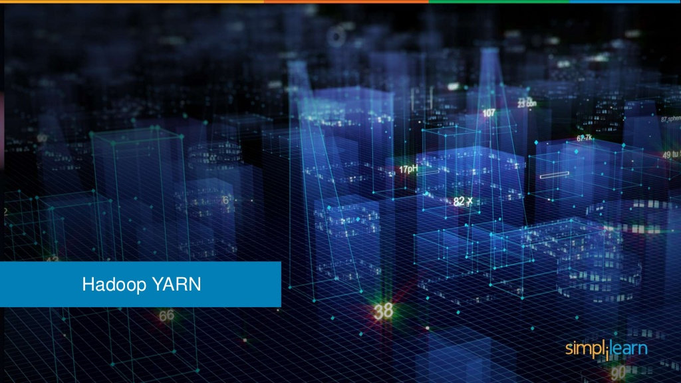

Slide 69
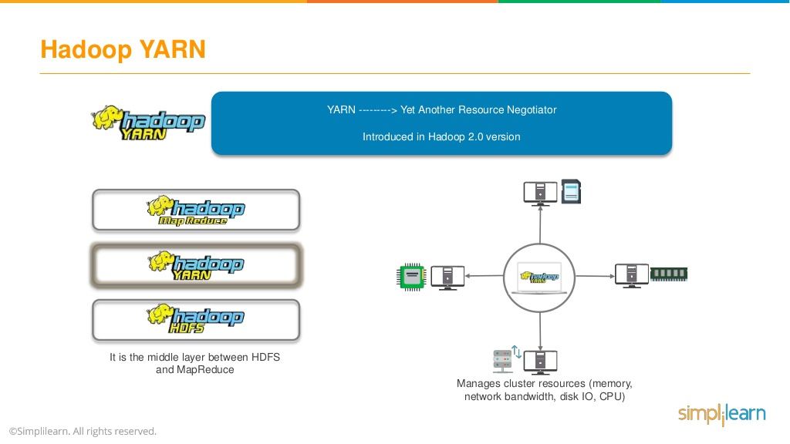

Notes:
HDFS is the storage layer, YARN is the processing layer of Hadoop.
YARN is a framework for managing distributed applications executed on multiple machines within a network).
YARN manages all resources in a Hadoop cluster like network, bandwidth, disk, CPU, memory
It is general enough to support other distributed computing like MapReduce, Spark, Graph, Real-time etc.

Slide 70

Notes:
YARN is Cluster resource management system that manages network, bandwidth, disk, CPU, memory

Slide 71


Slide 72

Notes:
Manages and allocates cluster resources.
Arbitrate requests for available resources made by competing applications
It optimizes the resource utilization on cluster through capacity guarantee, fairness and SLAs
RM enables pluggable schedulers such as capacity and fair utilization of resources
Initiates the startup of all YARN applications
Manages job scheduling and execution
Allocates resources globally on all the Data Nodes
It is a global scheduler

Slide 73

Notes:
RM has two components
Scheduler has a pluggable policy like CapacityScheduler and FairScheduler

Slide 74


Slide 75

YARN Scheduler - FIFO
Large applications will use all the resources in a cluster
Each application has to wait its turn.
Not recommended for Shared Cluster

Slide 76

YARN Scheduler - Capacity
A separate dedicated queue for small job.
Queue capacity is reserved for jobs in that queue.
Divides the overall capacity among multiple queues.
Large job finishes later than when using the FIFO Scheduler.

Slide 77

YARN Scheduler - Fair
No need to reserve a set amount of capacity
Dynamically balance resources between all running jobs.
First job gets all the resources in the cluster.
Second (small) job starts, it is allocated half of the cluster resources so that each job is using its fair share of resources.
Supports Preemption
Notes:
Preemption allows the scheduler to kill containers for queues that are running with more than their fair share of resources so that the resources can be allocated to a queue that is under its fair share. Note that preemption reduces overall cluster efficiency, since the terminated containers need to be reexecuted.

Slide 78

Notes:
Application manager is responsible for maintaining a list of submitted application.
After application is submitted by the client, application manager firstly validates whether application requirement of resources for its application master can be satisfied or not.
If enough resources are available then it forwards the application to scheduler otherwise application will be rejected.
It also make sure that no other application is submitted with same application id.

Slide 79


Notes:
It is yarn’s per worker node agent
It takes care of individual compute nodes in a Hadoop cluster.
Keeping up to date with Resource Manager
Monitoring resource usage like memory, cpu, network etc. of individual containers
On Startup, Node Manager, registers with Resource Manager and sends Heartbeat for status and resources information.
Primary responsibility is to manage containers assigned by Resource Manager
Node manager creates container based on the specification, manages its lifecycle and kills when no more required.

Slide 80

Notes:
Containers are collection of physical resources such as RAM, CPU core, disks, network etc.
Depending on the processing needs, FIFO or FairShare Capacity scheduler can be configured.
There can be multiple containers on a single node
Every node in the system is composed of multiple containers if minimum size defined in configuration for RAM, CPU core etc.
The AM, can request as many to occupy the multiple to meet its needs.
Container is supervised by the Node Manager and scheduled by the Resource Manager.

Slide 81


Notes:
AM is the process that coordinates an applications execution in the cluster.
Each application has its own unique AM, which is tasked with negotiating resources (containers) from the Resource Manager and working with Node Manager to execute and monitor tasks.
AM is also a container, which is often referred to as container 0.
It tracks the status of different jobs running on the various containers on different nodes in the cluster.
When AM is started, it sends periodic Heartbeat to Resource Manager to affirm its health and update the record of its resource demands.
It builds its requirement model and send it along the Heartbeat message to RM. As a response, AM, will receive a lease of containers allocated on a particular node in cluster.
Depending on the available resource lease from RM, AM updates its plan about lack or excess of resources and executes jobs slower or faster accordingly.
Container allocation and de-allocation can take place dynamically as application progresses.
AM helps yarn in providing scalability.
Simulations results shows that jobs can scale to 10,000 nodes on modern hardware without any degradation in performance.
AM manages the fault-tolerance of application as well. If a job fails, it manages its re-execution as well.

Slide 82

Notes:
YARN depends on a cluster-wide ResourceManager, which is the authoritative arbitrator
of resources among all the applications running in a Hadoop cluster.
The ResourceManager works together with a NodeManager (NM) that runs on every worker node (DataNode)
in the cluster.
Together, the single ResourceManager and the per-node NodeManagers form the data computation framework.
Each of the applications that run on YARN has an ApplicationMaster (AM) associated with it.
The ApplicationMaster’s main purpose is to negotiate with the ResourceManager for resources and work with the NodeManagers to execute the tasks that are part of each
application.
Following are the key functions of the ResourceManager:
Creates the first container for an application. This is the container in which the ApplicationMaster for the application will run.
Tracks the heartbeats from the NodeManagers to manage the DataNodes.
Runs a Scheduler to determine resource allocation among the clusters.
Manages cluster level security.
Manages the resource requests from the ApplicationMasters.
Monitors the status of the ApplicationMaster and restarts that container upon its failure.
Deallocates the containers when the application completes or after they expire.
Each DataNode in a Hadoop 2 cluster runs a NodeManager daemon for performing YARN functions (the DataNodes also run a DataNode daemon for performing HDFS
functions).
The per-node NodeManager agent performs the following functions:
Communicates with the global ResourceManager through health heartbeats and container status notifications.
Registers and starts the application processes.
Launches both the ApplicationMaster and the rest of an application’s resource containers (that is, the map and reduce tasks that run in the containers) on request from the ApplicationsManager.
Oversees the lifecycle of the application containers.
Monitors, manages and provides information regarding the resource consumption (CPU/memory) by the containers.
Tracks the health of the DataNodes.
Monitors container resource usage and kills runaway processes.
Handles log management by aggregating the job logs and saving them to HDFS.
There’s a single, dedicated ApplicationMaster for each YARN application (same as a job).
The ApplicationMaster’s main functions are:
Managing task scheduling and execution
Allocating resources locally for the application’s tasks
if there are no currently running applications, there won’t be an ApplicationMaster process running.
It’s important to remember that the ApplicationMaster tracks job progress for a specific application.
Each time a new application starts, the ResourceManager deploys a container running the ApplicationMaster on one of the cluster’s nodes.
The ApplicationMaster isn’t a continuously running daemon (unlike the ResourceManager and NodeManager daemons)—rather, it’s application specific.
Each application that runs in the cluster is associated with a single ApplicationMaster, which starts when the application is started and is terminated when that application completes.
The ApplicationMaster is in charge of the entire lifecycle of an application, from requesting the necessary containers from the ResourceManager to submitting lease requests to NodeManagers for those
containers.

Slide 83


Slide 84

Notes:
Client submits the MapReduce v2 (MRv2) application request, such as the following,
to the ResourceManager.

Slide 85

Notes:
RM returns the application Id

Slide 86


Slide 87

Notes:
The ApplicationManager component of the ResourceManager directs a NodeManager
(there’s one of these running on each worker node) to start a new ApplicationMaster
instance for the application.
This is Container 0 for that application.
Containers created later on to run the mapper and reducer processes will be named 01, 02, 03
and so on.
The ApplicationMaster initializes itself by registering with the ResourceManager.
The ApplicationMaster calculates the processing resources necessary to complete the application.
The ApplicationMaster determines the number of map tasks that should be started up, based on the input splits.
It calculates the input splits by requesting the names and locations of the input files and data blocks required by the application.
Using this information, the ApplicationMaster calculates how many map tasks are required to process the input data.
The ApplicationMaster requests the ResourceManager to assign the necessary containers for the map tasks. It stays in contact with the ResourceManager throughout
the lifecycle of the application, assuring that its list of required resources is being honored by the ResourceManager and also sending any necessary kill requests for
killing tasks.
If the container is not available then job waits.

Slide 88

Notes:
The Scheduler component of the ResourceManager determines on which nodes to
run the map tasks. Key factors in the determination include data locality and available
memory to support the new containers to be created on the nodes for the tasks to run
in. The ResourceManager queues the resource requests from the ApplicationMaster
and grants it leases for containers on specific nodes as resources become available on
those nodes.

Slide 89

Notes:
Once NM received lease of containers,
The ApplicationMaster directs the NodeManager, on the nodes where the containers
have been assigned, to create the containers.
The NodeManager creates the requested containers and starts them.
Containers send MapReduce status to the ApplicationMaster. (There’s only one of these
per job.)

Slide 90

Notes:
The ApplicationMaster requests the ResourceManager for reducer tasks (if the
MapReduce application contains reducers—some don’t).
The ApplicationMaster requests the NodeManager to launch the reduce tasks on
nodes where the ResourceManager allocates resources for the Reduce tasks.
The reduce tasks perform the shuff le and sort with the mapper’s intermediate
data and store the output in HDFS (outdir).
The NodeManager sends status and health reports to the ResourceManager.
Once all tasks are completed, the ApplicationMaster sends the results to the client
application. It also sends the job information and logs to the JobHistoryServer.
Task containers clean up their state and the intermediate output is deleted from
the local file system.
Once an application completes running, the ApplicationMaster informs the
ResourceManager that the job has successfully completed and deregisters itself
from the ResourceManager and shuts down.
The ResourceManager releases all the resources (containers) held by the application
for reuse by the cluster.

Slide 91


Slide 92


Slide 93


Slide 94

Notes:
introduced in Hadoop 2 to improve the MapReduce implementation,
It is general enough to support other distributed computing like MapReduce, Spark, Graph, Real-time analysis etc.

Slide 95


Slide 96
References
https://www.oreilly.com/library/view/hadoop-the-definitive/9781491901687/ch04.html
https://www.simplilearn.com/
https://www.edureka.co/
https://data-flair.training/blogs/hadoop-tutorial/
https://financesonline.com/what-is-big-data-analytics-and-how-it-helps-you-understand-your-customers/

Slide 97


